Slide 1

Relay Overcurrent Protection Simulation
Zane Richards & Nate Fischer
November 20, 2025

Slide 2
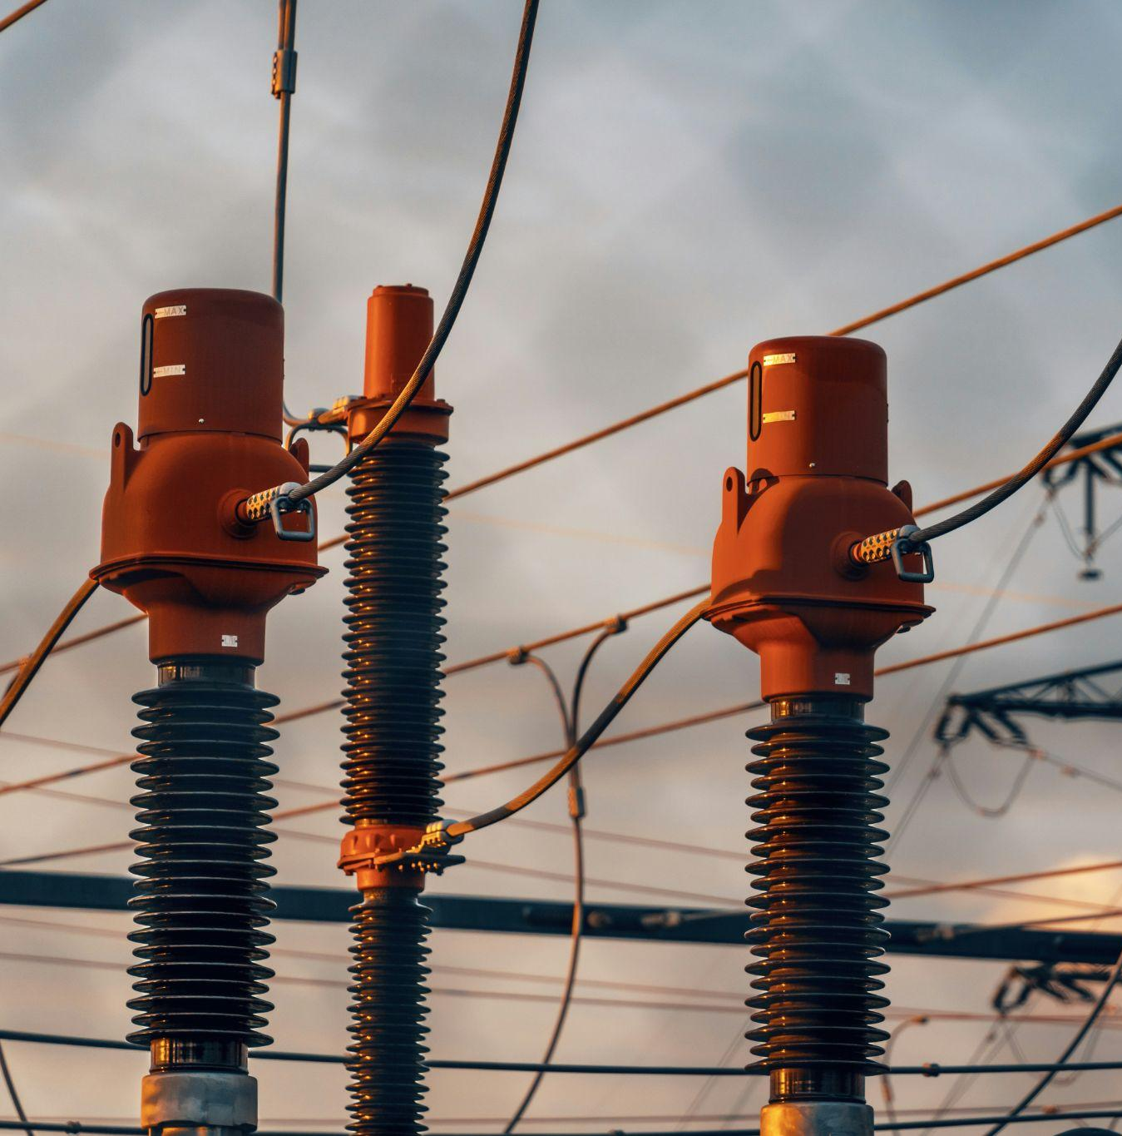
Why Grid Protection Matters
The electrical grid needs protection because faults happen:
Short circuits, trees touching lines, equipment failure, etc.
Faults cause very large currents which can:
Damage equipment
Cause fires
Create large blackouts
Protection systems detect abnormal electrical conditions and disconnect the damaged part of the system.

Slide 3

11/20/2025
Project Goal & Scope
Model a 13.8kV Feeder With Faults
MATLAB Simulation
Analyze Relay Operation for 3 Fault Types
Research
Notes:
Nate

Slide 4
System Overview
Overcurrent Relay
Current Transformer
Feeder
The system that is being simulated
Part of the power distribution system that carries electricity from a substation to neighborhoods, businesses, etc.
The “main branch” of a local distribution grid
First line of defense in feeder systems
Circuit breaker with a brain
Instantly breaks the circuit if there is an extreme fault
Waits a set amount of time before breaking the circuit if there is a non-extreme abnormality
Power lines carry hundreds to thousands of amps
Current transformers scale down current so that it can be measured
The relay uses the CT output (secondary) to make decisions
Notes:
Nate

Slide 5

Feeder
Current Transformer
Fault Point
Relay
Notes:
Nate

Slide 6
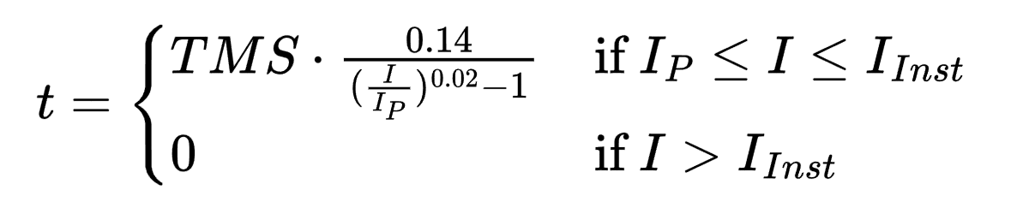
Relay Operation Logic
Reads current from the CT secondary side (stepped down current)
Instantly trips and breaks the circuit if there is an extreme abnormality
Waits a period before breaking if there is an abnormality that may not be a fault
Time is determined using IEC Standard Inverse Curve
Notes:
Zane

Slide 7
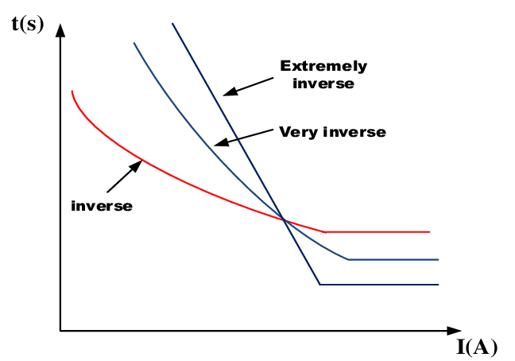
Notes:
Zane

Slide 8
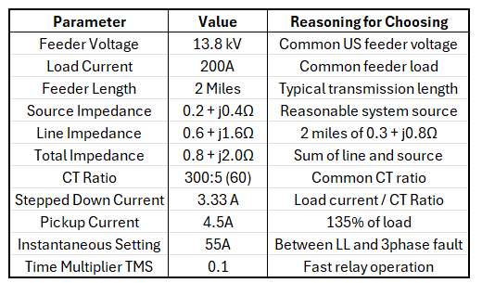
Chosen System Parameters
Notes:
Zane

Slide 9
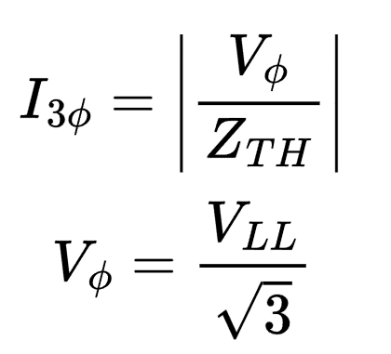
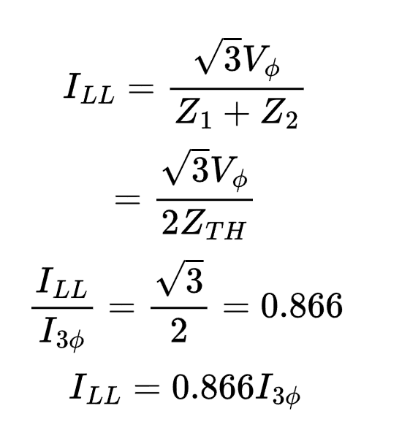
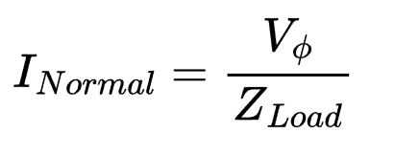
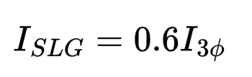
Fault Current Calculations
Three Phase Fault
Line to Line Fault
Line to Ground Fault
Values typically range from 0.5-0.7x the 3 Phase Fault Current
All 3 phases are shorted together
Two lines touch (2 phase fault)
Normal Condition
No Faults
Notes:
Zane

Slide 10
MATLAB Simulation overview
Input key parameters (feeder voltage, CT ratio, breakpoint currents, etc.)
Compute fault currents (both regular and stepped down values)
Generate a time-current curve based on the IEC formula
Analyze relay behavior and trip times
Notes:
Zane

Slide 11
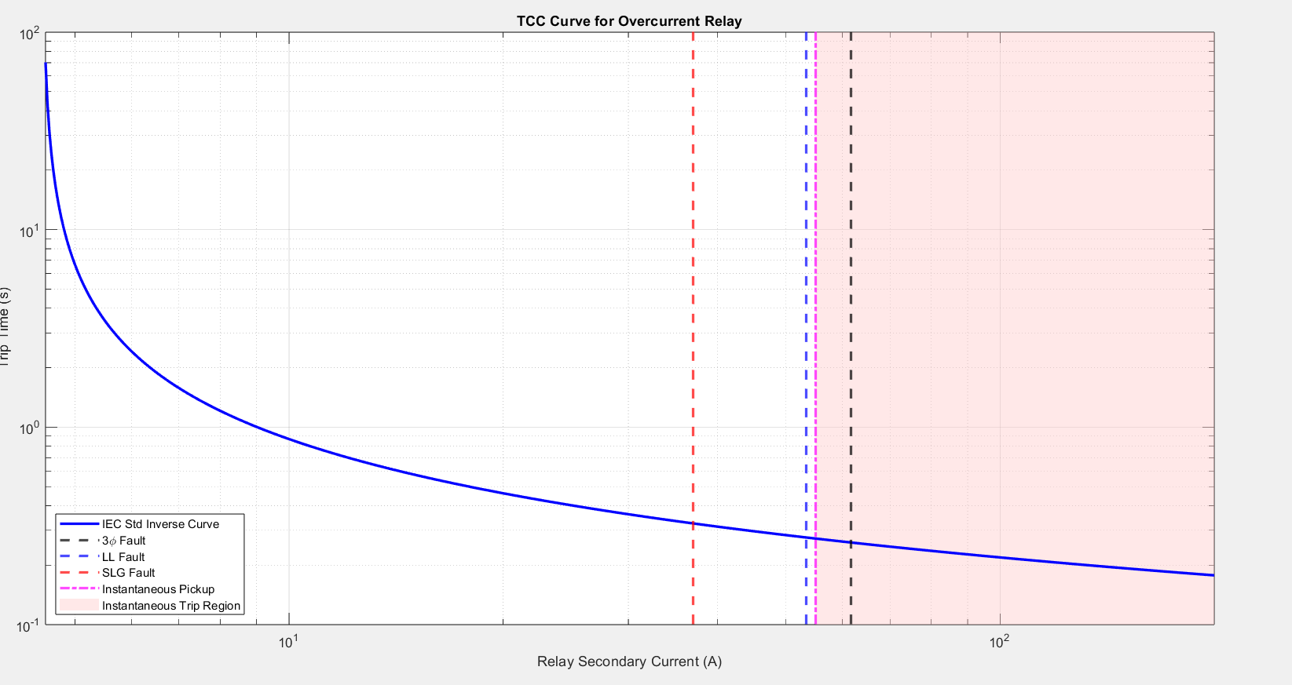
Notes:
Nate

Slide 12
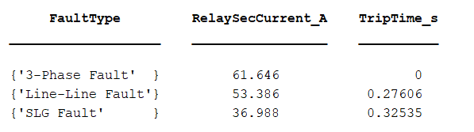
Notes:
Nate

Slide 13
Interpretations & Limitations
Our simulation behaves realistically
Extreme faults clear instantly, weaker faults clear with delay to reduce miscoordination
Line-to-Line and SLG faults were approximated
No transient modeling
Only models the initial circuit break and does not consider reclosing
Notes:
Nate

Slide 14
Possible Improvements
Apply coordination with downstream devices
1
Simulate recloser curves
2
Improve calculations of fault currents
3
Compare IEC vs. IEEE curves
4
Notes:
Nate

Slide 15
Questions?

